Slide 1




A Technical Deep Dive on IBM WebSphere Liberty & Open Liberty Think Academy Lab #2258
Grace Jansen
grace.jansen1@ibm.com
@gracejansen27
Jamie Coleman
jlcoleman@uk.ibm.com
@Jamie_Lee_C
Mary Grygleski
mary.grygleski@ibm.com
@mgrygles
Yee-Kang (YK) Chang
yeekangc@ca.ibm.com
@yeekangc

Slide 2
Please note
IBM’s statements regarding its plans, directions, and intent are subject to change or withdrawal without notice and at IBM’s sole discretion.
Information regarding potential future products is intended to outline our general product direction and it should not be relied on in making a purchasing decision.
The information mentioned regarding potential future products is not a commitment, promise, or legal obligation to deliver any material, code or functionality. Information about potential future products may not be incorporated into any contract.
The development, release, and timing of any future features or functionality described for our products remains at our sole discretion.
Performance is based on measurements and projections using standard IBM benchmarks in a controlled environment. The actual throughput or performance that any user will experience will vary depending upon many factors, including considerations such as the amount of multiprogramming in the user’s job stream, the I/O configuration, the storage configuration, and the workload processed. Therefore, no assurance can be given that an individual user will achieve results similar to those stated here.

Slide 3
Notices and disclaimers
© 2021 International Business Machines Corporation. No part of this document may be reproduced or transmitted in any form without written permission from IBM.
U.S. Government Users Restricted Rights — use, duplication or disclosure restricted by GSA ADP Schedule Contract with IBM.
This document is current as of the initial date of publication and may be changed by IBM at any time. Not all offerings are available in every country in which IBM operates.
Information in these presentations (including information relating to products that have not yet been announced by IBM) has been reviewed for accuracy as of the date of initial publication and could include unintentional technical or typographical errors. IBM shall have no responsibility to update this information. This document is distributed “as is” without any warranty, either express or implied. In no event, shall IBM be liable for any damage arising from the use of this information, including but not limited to, loss of data, business interruption, loss of profit or loss of opportunity. IBM products and services are warranted per the terms and conditions of the agreements under which they are provided. The performance data and client examples cited are presented for illustrative purposes only. Actual performance results may vary depending on specific configurations and operating conditions.
IBM products are manufactured from new parts or new and used parts. In some cases, a product may not be new and may have been previously installed. Regardless, our warranty terms apply.”
Any statements regarding IBM's future direction, intent or product plans are subject to change or withdrawal without notice.
Performance data contained herein was generally obtained in a controlled, isolated environments. Customer examples are presented as illustrations of how those customers have used IBM products and the results they may have achieved. Actual performance, cost, savings or other results in other operating environments may vary.
References in this document to IBM products, programs, or services does not imply that IBM intends to make such products, programs or services available in all countries in which IBM operates or does business.
Workshops, sessions and associated materials may have been prepared by independent session speakers, and do not necessarily reflect the views of IBM. All materials and discussions are provided for informational purposes only, and are neither intended to, nor shall constitute legal or other guidance or advice to any individual participant or their specific situation.

Slide 4
Notices and disclaimers continued
It is the customer’s responsibility to ensure its own compliance with legal requirements and to obtain advice of competent legal counsel as to the identification and interpretation of any relevant laws and regulatory requirements that may affect the customer’s business and any actions the customer may need to take to comply with such laws. IBM does not provide legal advice or represent or warrant that its services or products will ensure that the customer follows any law.
Information concerning non-IBM products was obtained from the suppliers of those products, their published announcements or other publicly available sources. IBM has not tested those products about this publication and cannot confirm the accuracy of performance, compatibility or any other claims related to non-IBM products. Questions on the capabilities of non-IBM products should be addressed to the suppliers of those products. IBM does not warrant the quality of any third-party products, or the ability of any such third-party products to interoperate with IBM’s products. IBM expressly disclaims all warranties, expressed or implied, including but not limited to, the implied warranties of merchantability and fitness for a purpose.
The provision of the information contained herein is not intended to, and does not, grant any right or license under any IBM patents, copyrights, trademarks or other intellectual property right.
IBM, the IBM logo, and ibm.com are trademarks of International Business Machines Corporation, registered in many jurisdictions worldwide. Other product and service names might be trademarks of IBM or other companies. A current list of IBM trademarks is available on the Web at “Copyright and trademark information” at: www.ibm.com/legal/copytrade.shtml.

Slide 5
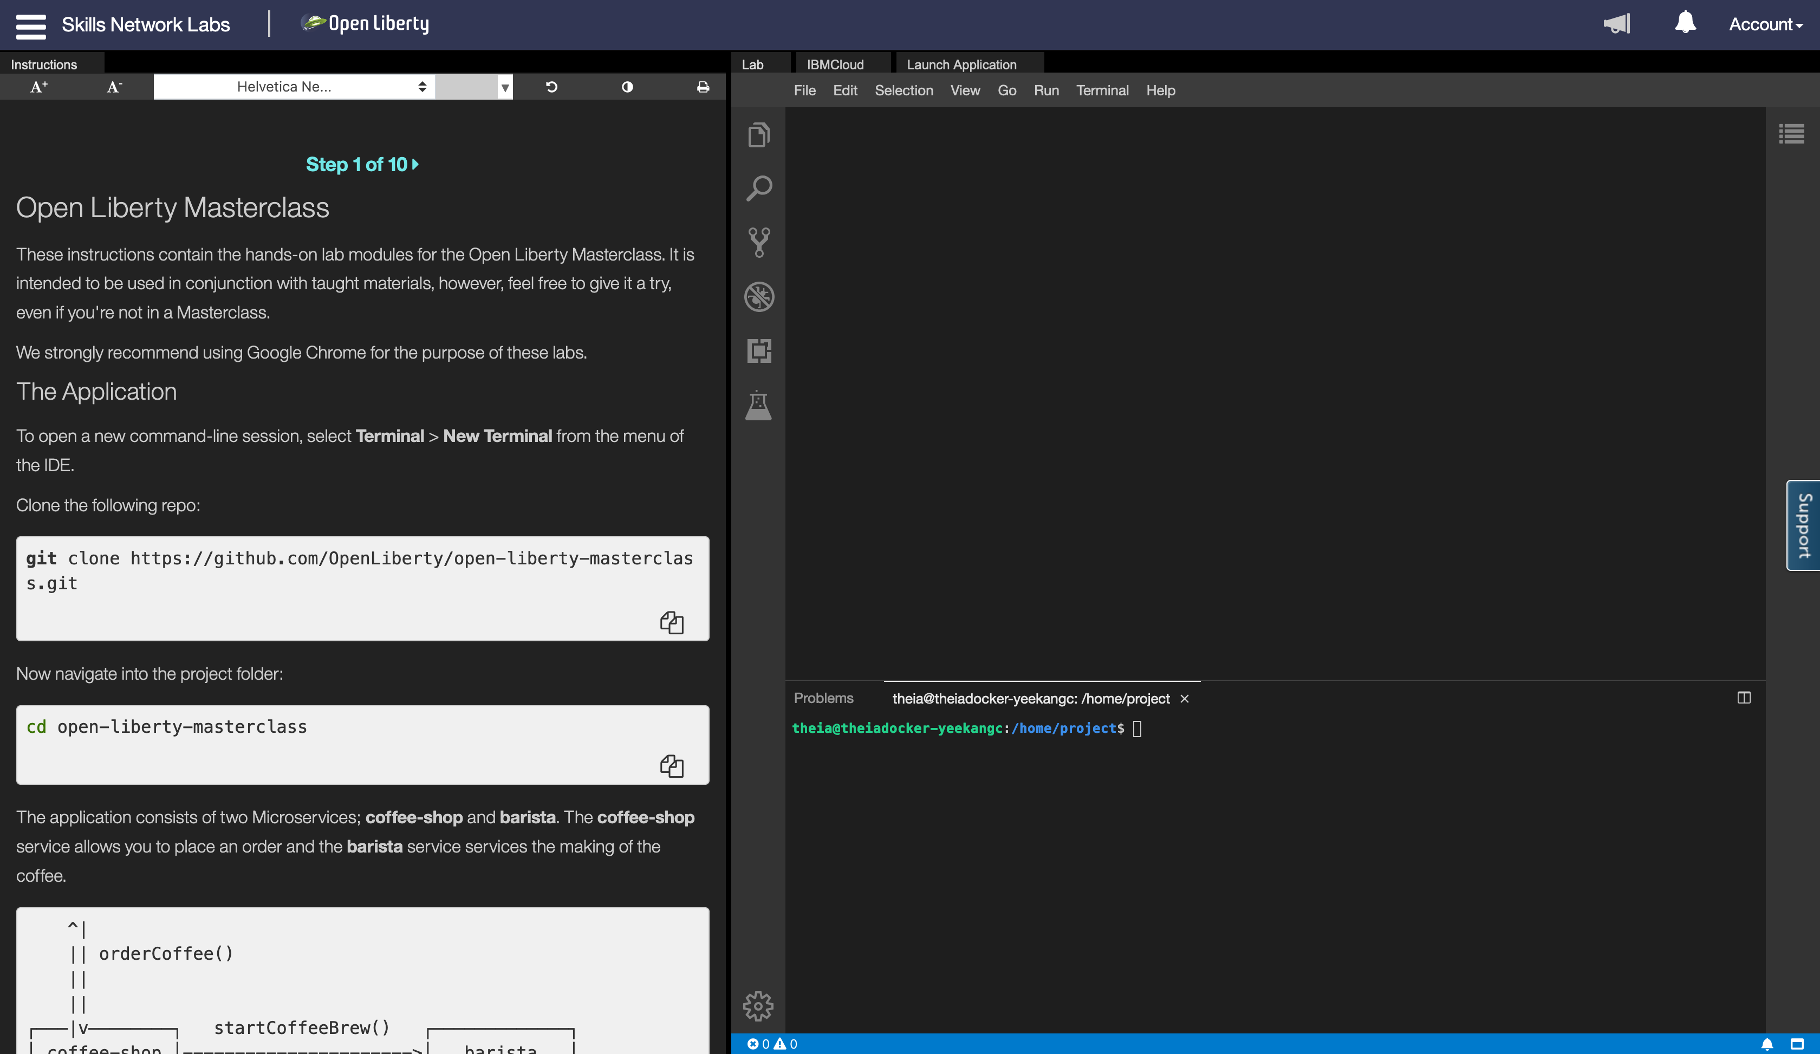
Ready to get your hands dirty?
Online exercises: https://ibm.biz/LibertyMasterclass
Hosted environment with an editor and a terminal that you can try online through your browser

Slide 6
Ready to get your hands dirty?
The Masterclass is open sourced at: https://github.com/OpenLiberty/open-liberty-masterclass
Follow the instructions in the ”Before you begin” section of the README.md to:
Install Pre-requisites
Prime Maven and Docker Caches

Slide 7
Mastersclass hands-on content
The Application
Module 1: Build
Module 2: Dev Mode
Module 3: Application APIs
Module 4: Server Configuration
Module 5: Externalizing Configuration
Module 6: Integration Testing
Module 7: Docker
Overriding Dev Server Configuration
Module 8: Testing in Containers
Module 9: Support Licensing
Conclusion

Slide 8
Background

Slide 9
6 reasons why Liberty
Just enough runtime
80% disk and 56% memory saving
Lightweight, highly-efficient runtime
CI/CD optimized operational experience
Simple true-to-production developer experience
Low operating cost
4x increased density over Tomcat & Spring Boot
Continuous delivery
Zero-effort security fixing & zero technical debt
Zero migration
100% v2v & fixpack migration saving
Kubernetes optimized
Self-tuned optimal perf, production-ready, kube-native
Developer experience
Container & kube-native experience, rapid inner loop

Slide 10
API Support
First shipped in WAS 8.5 in 2012
Servlet + JSP + JPA
Web Profile 6 in 2014
Java EE 7 in 2016 – first commercial product to certify
Java EE 8 in 2018 – first to certify
Jakarta EE 8 in 2019 – first to certify
Eclipse MicroProfile – first to deliver 1.0-1.4, 2.0-2.1, 3.0
Jakarta EE 9 – first vendor product to certify

Slide 11

openliberty.io
Launched September 2017

Slide 12
Liberty Architecture

Slide 13


Just Enough Application Server
You control which features are loaded into each server instance
Java EE
<feature>jaxrs-2.1</feature>
<feature>servlet-4.0</feature>
jaxrsClient-2.1
jsonp-1.1
jaxrs-2.1
servlet-4.0
appmgr
http-2.0
Kernel
Notes:
The server configuration allows you to control which features are loaded into a given server instance at a very fine-grained level, so you get exactly the function you want and no more.

Slide 14
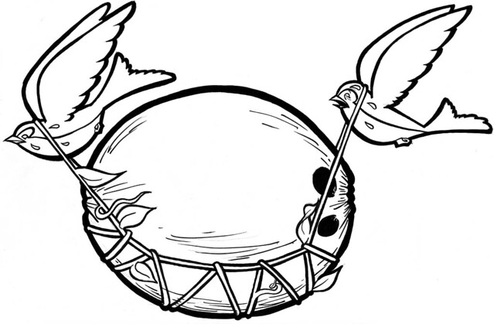
Liberty Zero Migration
Zero config migration
Write once, run forever
Zero app migration
No behavior changes in existing features
New behaviors in new features
Choose your Java
Java 15, 11, 8
AdoptOpenJDK
IBM
OpenJDK
Oracle

Slide 15
Features

Slide 16
Periodic Table of Liberty (21.0.0.3)
 | batchSMFLogging-1.0 | zosLocalAdapters-1.0 | zosTransaction-1.0
 |  | zosRequestLogging-1.0 | zosWlm-1.0 | zosSecurity-1.0
collectiveController-1.0 | dynamicRouting-1.0 | healthManager-1.0 | scalingController-1.0
 | clusterMember-1.0 | healthAnalyzer-1.0 | scalingMember-1.0
cloudant-1.0 | heritageAPIs-1.0 | batchManagement-1.0
javaee-7.0 | sipServlet-1.1 | wsAtomicTransaction-1.2 |  | passwordUtilities-1.0
javaee-8.0 |  |  |  | wsSecurity-1.1
jakartaee-8.0 |  |  |  | wsSecuritySaml-1.0
bells-1.0 | microProfile-4.0 | adminCenter-1.0 | acmeCA-1.0 | audit-1.0
concurrent-1.0 | mpContextPropagation-1.0 | collectiveMember-1.0 | constrainedDelegation-1.0 | ldapRegistry-3.0
grpc-1.0 | mpGraphQL-1.0 | distributedMap-1.0 | federatedRepository-1.0 | oauth-2.0
javaMail-1.6 | mpReactiveMessaging-1.0 | eventLogging-1.0 | jwt-1.0 | openid-2.0
jaxb-2.2 | mpReactiveStreams-1.0 | logstashCollector-1.0 | jwtSso-1.0 | openidConnectClient-1.0
jdbc-4.3 | opentracing-1.3 | monitor-1.0 | sessionDatabase-1.0 | openidConnectServer-1.0
jpaContainer-2.2 | osgiConsole-1.0 | openapi-3.1 | webCache-1.0 | samlWeb-2.0
jsfContainer-2.3 | springBoot-2.0 | requestTiming-1.0 |  | scim-1.0
json-1.0 | webProfile-7.0 | usageMetering-1.0 |  | socialLogin-1.0
jsonbContainer-1.0 | webProfile-8.0 | restConnector-2.0 |  | spnego-1.0
jsonpContainer-1.1 |  | sessionCache-1.0 |  | transportSecurity-1.0
zOS
Security
ND
Operations
Base
Core
Open Liberty
New in 4Q20
New in 3Q20
New in 2Q20
New in 1Q21
APIs
Notes:
Stabilized features are not shown. See https://www.ibm.com/support/knowledgecenter/en/SSEQTP_liberty/com.ibm.websphere.wlp.doc/ae/rwlp_stabfeat.html
Where there are multiple features of same version most recent is shown.

Slide 17
Build
Module 1

Slide 18
Support for Maven and Gradle
Manage full server and application lifecycle through the two most popular build technologies.
Maven
liberty-maven-plugin
liberty-archetype-*
Docs & Source: https://github.com/OpenLiberty/ci.maven
Gradle
liberty-gradle-plugin
Docs & Source: https://github.com/OpenLiberty/ci.gradle
All the artefacts you need in Maven Central
https://search.maven.org/search?q=io.openliberty
https://search.maven.org/search?q=com.ibm.websphere

Slide 19
Dev Mode
Module 2

Slide 20

dev mode
Boosts developer productivity
Immediate feedback for code and config changes
No re-build necessary
Hot deployment, testing and debugging
In containers for near-production testing
mvn liberty:dev
mvn liberty:devc
gradle libertyDev
gradle libertyDevc

Slide 21
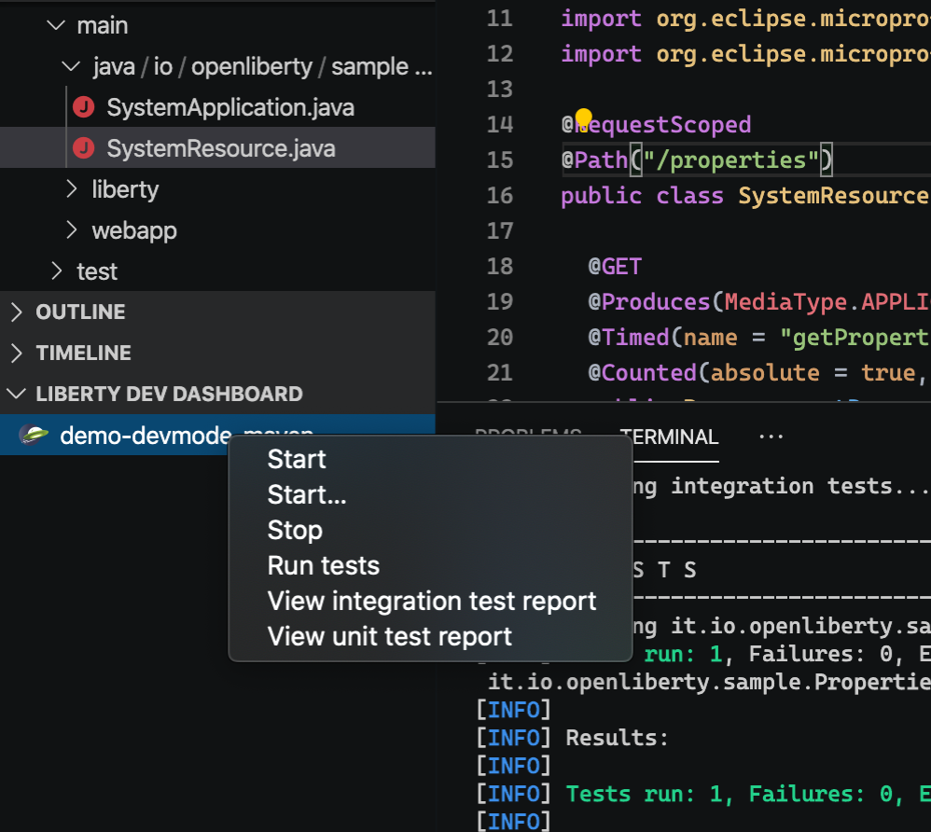
Tools
Open Liberty Tools for VS Code, IntelliJ & Eclipse
Start/Stop server
Run tests
View test reports
MicroProfile Starter
Create a new custom Microservice project within the IDE
MicroProfile REST Client Generator
Generate a REST client based on an OpenAPI definition

Slide 22










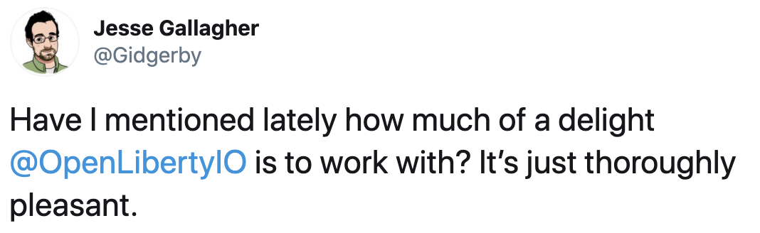
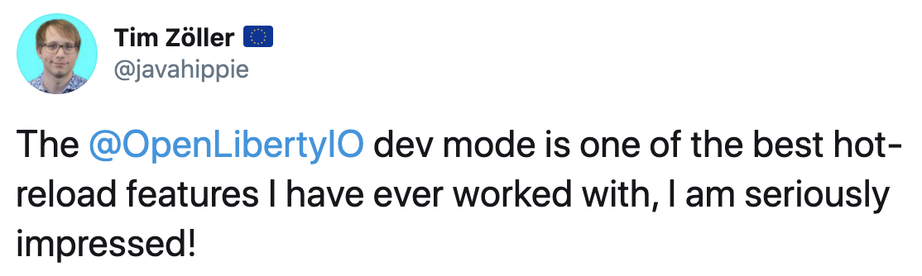
Developer experience
IDEs
Repositories
Build
Dev Mode
APIs
Testing

Slide 23
Application APIs
Module 3

Slide 24
Java EE 7
appClientSupport-1.0 | ejbPersistentTimer-3.2 | jaspic-1.1 | managedBeans-1.0
batch-1.0 | ejbRemote-3.2 | jaxb-2.2 | mdb-3.2
concurrent-1.0 | j2eeManagement-1.1 | jaxws-2.2 | wasJmsClient-2.0
ejb-3.2 | javaMail-1.5 | jca-1.7 | webProfile-7.0
ejbHome-3.2 | jacc-1.5 | jms-2.0 | wmqJmsClient-2.0
appSecurity-2.0 | jaxrsClient-2.0 | jsp-2.3
beanValidation-1.1 | jdbc-4.2 | managedBeans-1.0
cdi-1.2 | jndi-1.0 | servlet-3.1
ejbLite-3.2 | jpa-2.1 | ssl-1.0
el-3.0 | jsonp-1.0 | websocket-1.1
jaxrs-2.0 | jsf-2.2

Slide 25
Jakarta EE or Java EE 8
appClientSupport-1.0 | ejbHome-3.2 | jacc-1.5 | managedBeans-1.0
appSecurityClient-1.0 | ejbPersistentTimer-3.2 | jaxb-2.2 | mdb-3.2
batch-1.0 | ejbRemote-3.2 | jaxws-2.2 | wasJmsClient-2.0
concurrent-1.0 | j2eeManagement-1.1 | jca-1.7 | webProfile-8.0
ejb-3.2 | javaMail-1.6 | jms-2.0 | wmqJmsClient-2.0
appSecurity-3.0 | jaxrs-2.1 | jsonp-1.1 | websocket-1.1
beanValidation-2.0 | jaxrsClient-2.1 | jsf-2.3
cdi-2.0 | jdbc-4.2 | jsp-2.3
ejbLite-3.2 | jndi-1.0 | managedBeans-1.0
el-3.0 | jpa-2.2 | servlet-4.0
jaspic-1.1 | jsonb-1.0 | ssl-1.0

Slide 26
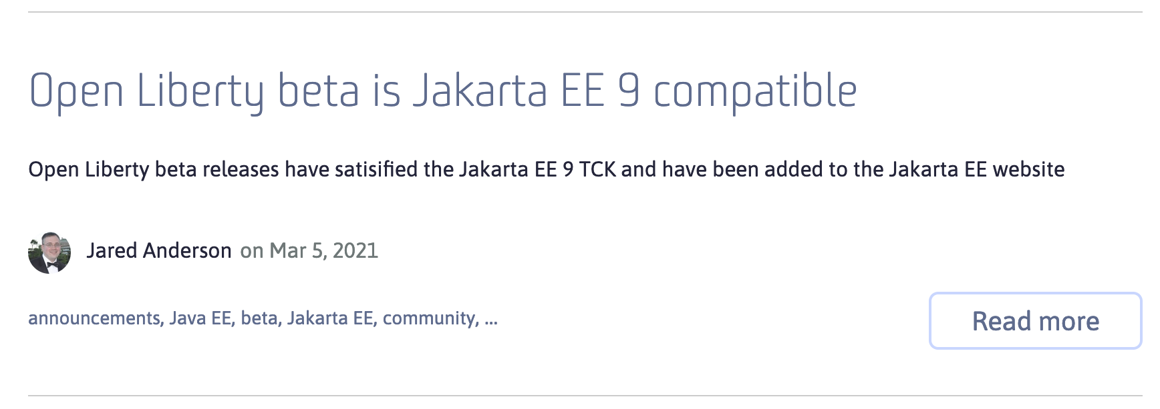
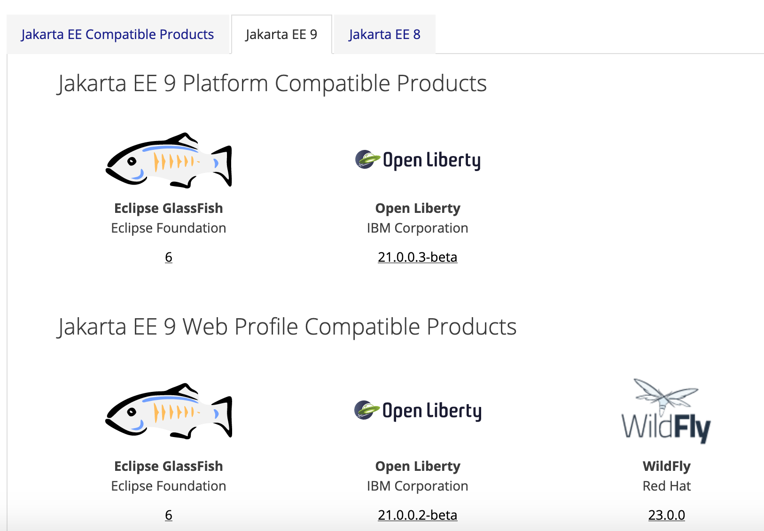

javax.* -> jakarta.*
https://openliberty.io/blog/2021/03/05/jakarta-ee-9-compatibility.html
https://jakarta.ee/compatibility/#tab-9
Notes:
Recently, we announced our full compatibility for Jakarta EE 9, for both the whole platform and web profile.
Liberty was the first implementation to declare full compatibility outside of the reference implementation.
You can try all the features for Jakarta EE 9 in the 21.0.0.2 beta release of Open Liberty.

Slide 27

Open cloud-native Java APIs
https://microprofile.io/
Observe
Open Telemetry
Open Tracing
Health Check
Metrics
Integrate
GraphQL
Reactive Messaging
OpenAPI
Fault Tolerance
JWT
Core
Config
JAX-RS
CDI
Rest Client
JSON-B
JSON-P
Notes:
Eclipse MicroProfile is a set of cloud native capabilities, implemented by our Java runtimes, that provide standard applications annotations implementations for applications to use in containers – building on a core of familiar Java EE technologies. LRA is one of the newest MicroProfile specificactions, derived from WS-BA, to provide a simple compensating transaction for Java microservices.
The blue specs are part of the MicroProfile 3.3 release. ReactiveMessaging and LRA are standalone specs.
The LRA model provides a good balance between a loosely coupled transaction model that preserves independence of application lifecycle of each microservce and application simplicity over maintaining data consistency in the presence of failure. Simple Java annotations are used to register completion and compensation tasks while the platfrom takes care of ensuring these get invoked appropriately, across any form of system failure.

Slide 28
MicroProfile
Builds on Java EE
By the Java EE community
Open Source at Eclipse
Multiple Implementations
@Path(“/”)
public class RestEE {
@GET @Counter @Traced
public String hello() {
return "Hello MicroProfile!!";
}
}
Notes:
@Bulkhead allows you to specify number of concurrent requests. waitingTaskQueue allows requests to be queued rather than failing. To use waitingTaskQueue, you also need to specify @Asynchronous to prevent immediate rejection.

Slide 29
Server Configuration
Module 4

Slide 30
Simple Config
<server>
<featureManager>
<feature>jaxrs-2.1</feature>
</featureManager>
<webApplication location=“myweb.war” contextRoot=“/” />
<applicationManager autoExpand="true"/>
</server>
server.xml
-Xmx1g
-Dsystem.prop=value
WLP_OUTPUT_DIR=/usr/wlp-out/
jvm.options
server.env

Slide 31
Composing Config
<server>
<httpEndpoint id=“defaultHttpEndpoint” host=“${host}” httpPort=“${http}” httpsPort=“${https}”/> </server>
configDropins/defaults/common-http.xml
<server>
<include location="https://myHost/ports.xml”/>
<variable name=“host” value=“${my.host}”/>
<variable name=“http” value=“${my.host.http}”/>
<variable name=“https” value=“${my.host.https}”/> </server>
configDropins/overrides/ports.xml
Notes:
Mention you can check in config.

Slide 32
Externalizing Configuration
Module 5

Slide 33
Variable Resolution
Liberty variable resolution happens top to bottom
server variables
Java system properties
bootstrap properties
env vars
Notes:
33
Describe background information that will be useful to help understand how this feature will be used or integrated into the product. Use this slide to cover existing concepts and the Key Concepts chart to cover new material that will need documentation.

Slide 34
Externalizing Config
<server>
<httpEndpoint id=“defaultHttpEndpoint” host=“*” httpPort=“${env.SERVER_HTTP_PORT}” httpsPort=“${env.SERVER_HTTPS_PORT}”/> </server>
configDropins/defaults/common-http.xml
Notes:
Mention you can check in config.

Slide 35
MicroProfile
Inject Configuration
Sourced from
Properties file
Environment
Java system properties
@Path(“/”)
public class RestEE {
@Inject @ConfigProperty(“name”)
private String name;
@GET @Counter @Traced
public String hello() {
return "Hello " + name;
}
}
Notes:
@Bulkhead allows you to specify number of concurrent requests. waitingTaskQueue allows requests to be queued rather than failing. To use waitingTaskQueue, you also need to specify @Asynchronous to prevent immediate rejection.

Slide 36
Testing
Module 6

Slide 37
Testing
Use maven-surefire-plugin to run unit test
Use CDI dependency injection to make your code easy to mock & unit test
Use maven-failsafe-plugin to run integration test
Use Liberty Arquillian integration to run tests on a Liberty server
Use MicroShed Testing for system testing in Containers (Module 8)

Slide 38
Docker
Module 7

Slide 39


Liberty in Containers
IBM Cloud Kubernetes Service
app and config
Azure Kubernetes Service
Hosted Cloud
+
Google Kubernetes Engine
Amazon Elastic Kubernetes Service
liberty and java
Jelastic
=
+
os config
portable container
Red Hat Open Shift Container Platform
+
Private Cloud
Pivotal Kubernetes Service
Pivotal Cloud Foundry
docker
FROM open-liberty
ADD myapp.war /config/dropins/myapp.war
Notes:
In any environment – bare metal, virtualised, cloud, containers – WAS is supported on a wide variety of operating systems and you can roll your own cloud using scripting, dev/ops tools, or a technology of your choice
* In the IBM Bluemix cloud, Liberty runs on all three compute options:
in the original Bluemix environment: CloudFoundry PaaS or ‘Instant Runtimes’, liberty provides the Java runtime
* in the IBM Container Service, liberty servers can be wrapped in portable Docker containers and managed by the container service
WAS can be installed and run in VMs provided by the OpenStack VM service which is currently in Beta
Just available this month is ‘IBM Application Server on Cloud in Bluemix’ which will let users rent WAS instances in a shared environment
more info on Bluemix compute options: https://developer.ibm.com/bluemix/2015/08/05/bluemix-instant-runtimes-containers-or-virtual-machines/
* Liberty can be easily installed and configured in a private IaaS environment. Pure Application patterns for WebSphere make the deployment of servers more efficient.
* Public IaaS options are also available:
on IBM’s SoftLayer you can install and configure Liberty directly onto rented VMs, or get pre-configured instances from the ‘IBM Application Server on Cloud’ service, this time in a dedicated environment. You can also rent WAS instances on Microsoft Azure and Amazon Web Services
If you choose a non-IBM PaaS you can also run Liberty there. There is an open-source buildpack for CloudFoundry and Heroku, which forms the core of the Bluemix buildpack so is highly functional and very well tested. That buildpack is also wrapped to provide the liberty cartridge for use in the OpenShift PaaS.
So we provide a wide choice of cloud environments for running WAS, and the bottom line is that WAS Liberty is technically small and simple enough to run in any environment, and we want to support you in running Liberty in whatever environment you choose.

Slide 40

Making the most of Docker
Application
Application
App Server
JVM
JVM
O/S
O/S
thin war
fat jar
Notes:
Alasdair
Talk about exploiting Docker and Docker layers.
FAT jars are not your friend.
Docker and Kube are your friend and really the future for deployment

Slide 41
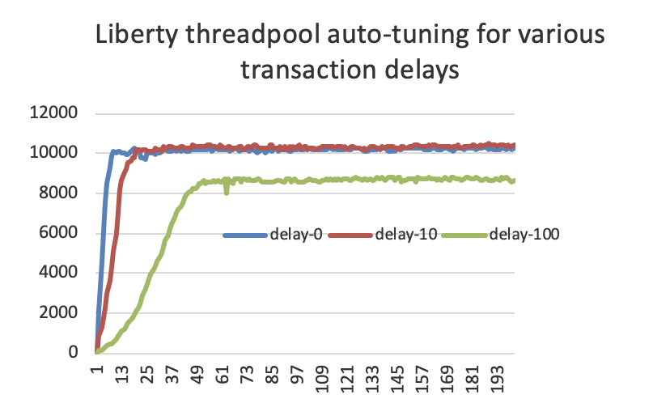
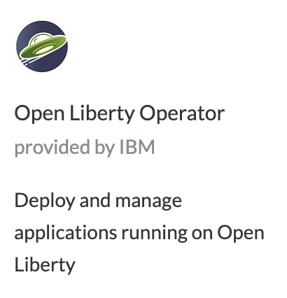


Kubernetes optimized
Deliver faster without costly tuning exercises
Get optimal performance even as the environment changes
Simple Operator-based deploy and day-2 operations experience
Supported production-ready images
APIs for Kubernetes integration
Container-based usage tracking

Slide 42
Testing in Containers
Module 8

Slide 43
MicroShed Testing
@MicroShedTest
public class MyTest {
// Search for Dockerfile.
// Start app in Container.
// Wait for Container before running tests.
@Container
public static MicroProfileApplication app
= new MicroProfileApplication()
.withAppContextRoot("/myservice");
// Inject JAX-RS REST Client
@Inject
public static MyService mySvc;
// A test method like any other
@Test
public void testMyService() {
...
}
}
Integration tests that are easy to setup, write, and run
Test your apps the same way they run in production...in Containers
Can run multiple containers on same network (e.g. test DB integration)
https://microshed.github.io/

Slide 44
Support Licensing
Module 9

Slide 45



How to get Support
WebSphere
WebSphere Hybrid Edition
IBM Integrated Application Runtimes
Java:
WebSphere
Liberty
MicroProfile
Jakarta EE
OpenJ9
z/OS
ND
Base
Core
Cloud Foundry Migration Runtime
Transformation Advisor
Mono2Micro
Red Hat OpenShift

Slide 46
Wrap-up

Slide 47
Mastersclass hands-on content
Open Liberty Masterclass
Table of Contents
Before you begin
Install Pre-requisites
Prime Maven and Docker Caches
The Application
Module 1: Build
Module 2: Dev Mode
Module 3: Application APIs
Module 4: Server Configuration
Module 5: Externalizing Configuration
Module 6: Integration Testing
Module 7: Docker
Overriding Dev Server Configuration
Module 8: Support Licensing
Conclusion

Slide 48
